Slide 1


Dissolved Oxygen Case Study
UNCLASSIFIED
Barry Bunch, DE, PE
U.S. Army Corps of Engineers, New Orleans District
U.S. Army Engineer Research and Development Center, Environmental Laboratory
CE-QUAL-W2 Workshop
August 16 - 18, 2022
Environmental Systems
Modeling Team
UNCLASSIFIED

Slide 2
CE-QUAL-W2 DO
Complete model DO process
Typically reduced suite of variables and processes
Minimum required:
Dissolved Oxygen
Reaeration
Oxygen demand

Slide 3
CE-QUAL-W2 DO
TEMPERATURE FIRST

Slide 4

DO Modeling Requirements
Typical Sources:
Boundary Conditions for all inflows
Initial Conditions for water body
Reaeration
Typical Sinks
Water quality variables that utilize DO in their kinetic processes
CBOD, DOM, POM, SOD, etc…
Interactions in the DO cycle are temperature dependent.
Efforts to model DO without reasonable temperature model are futile.

Slide 5
DO Modeling Requirements (cont.)
Dissolved Oxygen Observed Data
Boundary conditions
Estimates of initial conditions
In-situ comparisons with model predictions for Calibration/Validation
Understanding of system behavior and model performance
Oxygen Sinks
Boundary conditions and in-situ values
External loadings (Point and Non-point source)
Sediments
Meteorological Data

Slide 6
Model DO Performance
Compare Model output with observations
Evaluate Model DO performance using:
Time Series
Water Column Profiles
Statistics
Incorporate model Temperature performance in assessment, aka does it look right?

Slide 7
Minnesota River DO

Slide 8
Minnesota River DO (cont.)

Slide 9
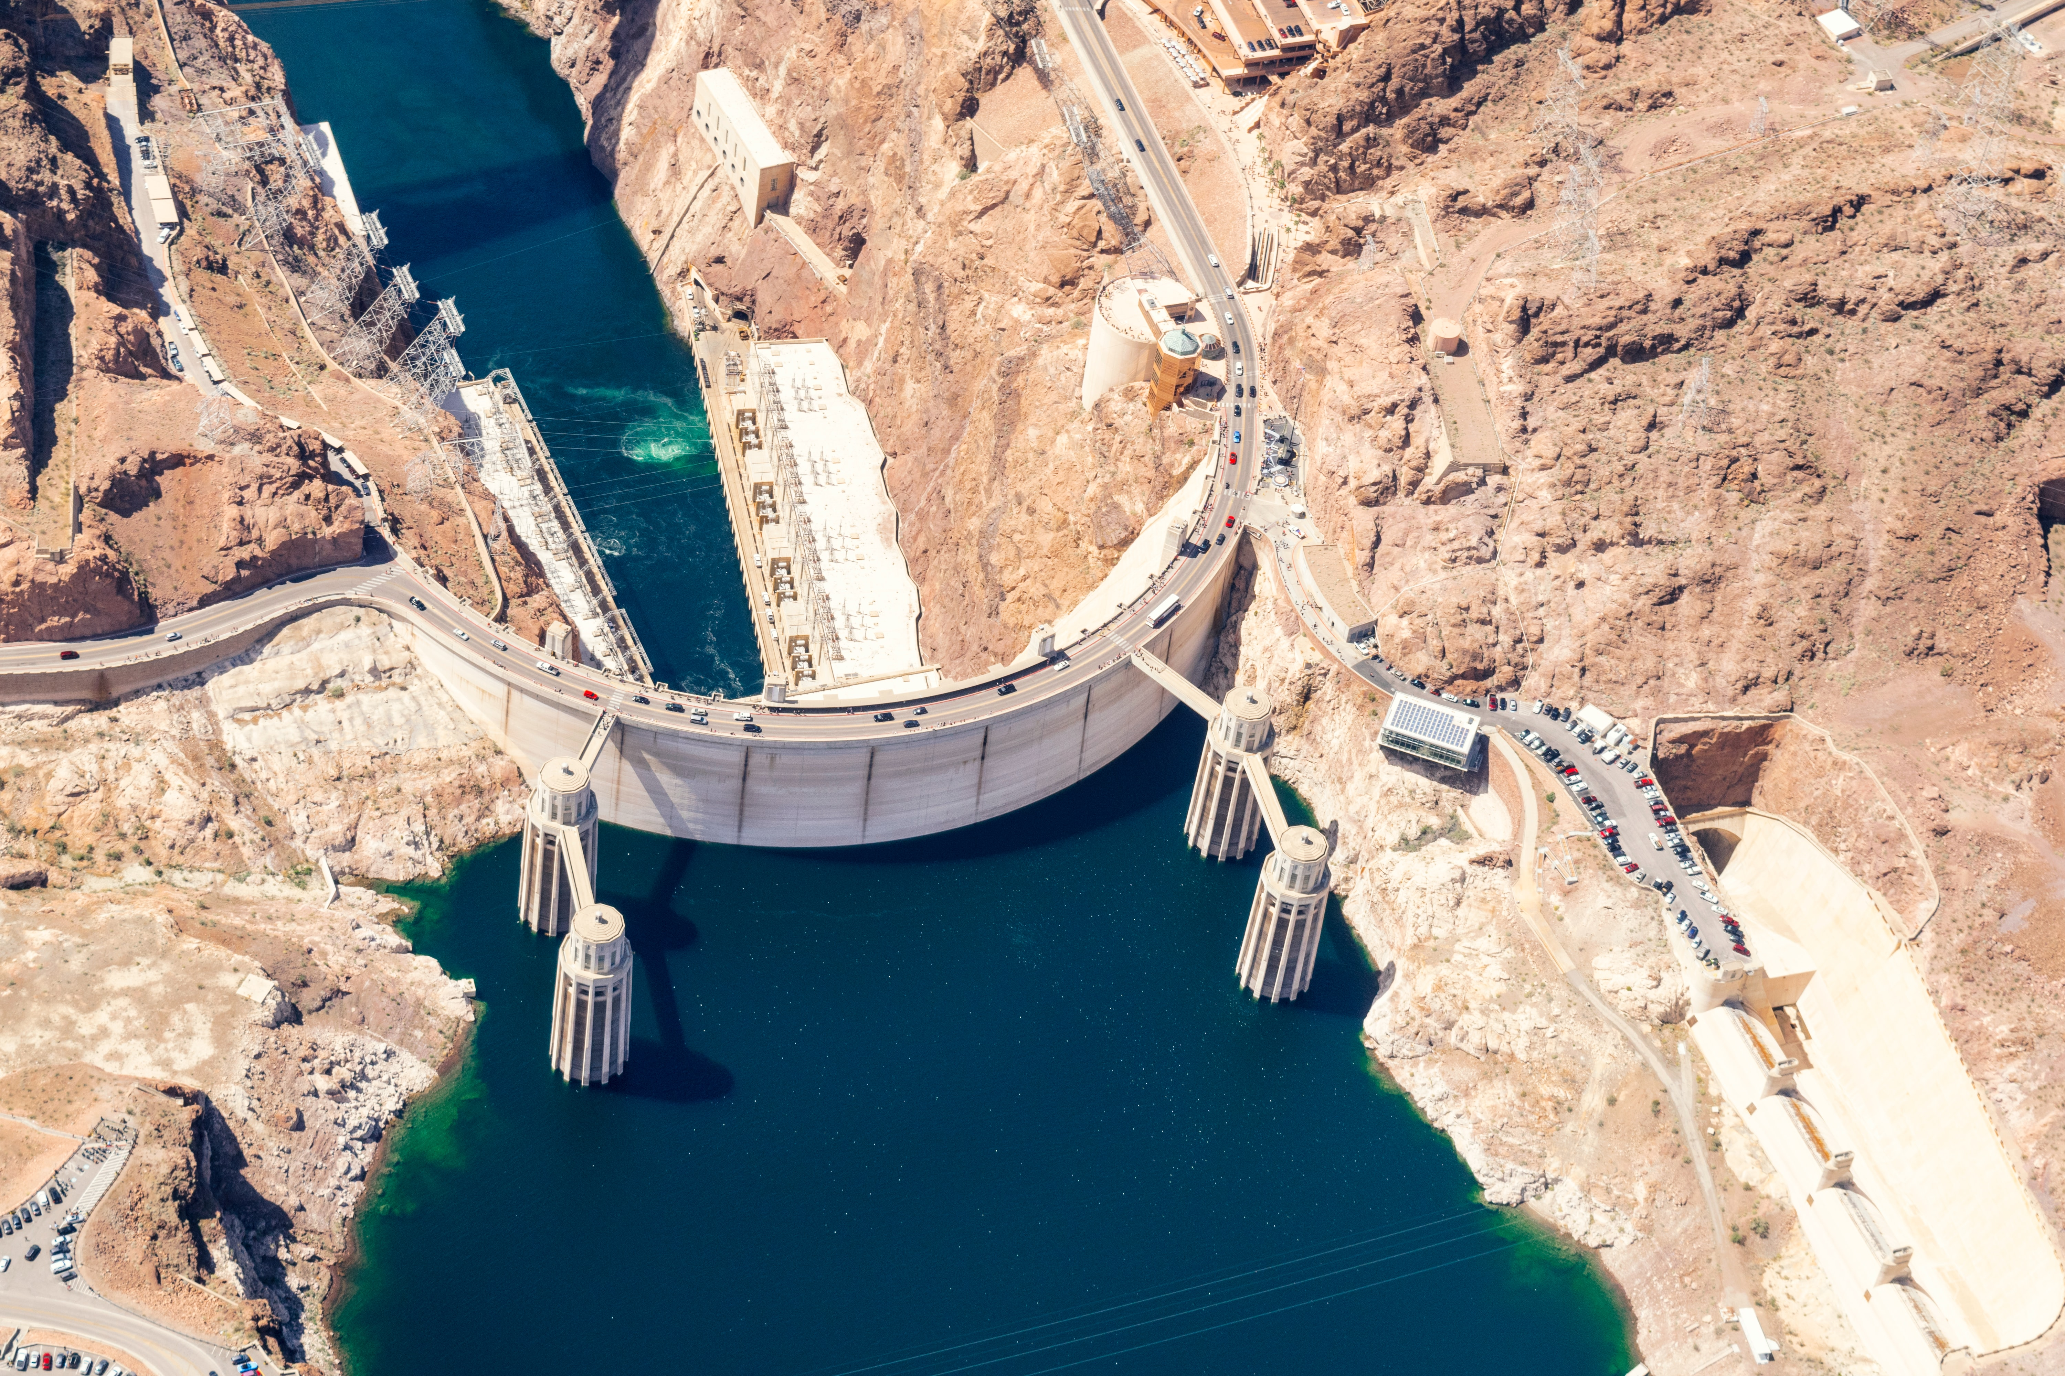
Evaluating Model DO Performance
DO is culmination of all other processes occurring in model.
DO Predictions sensitive or insensitive depending upon location and conditions in model.
Proceed slowly

Slide 10

Questions?

